Slide 1
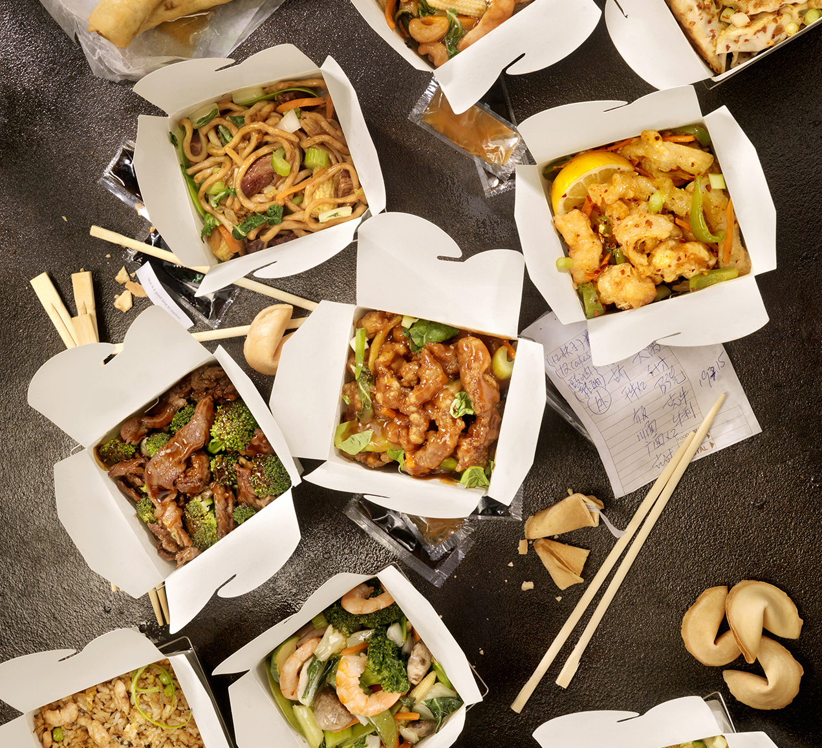
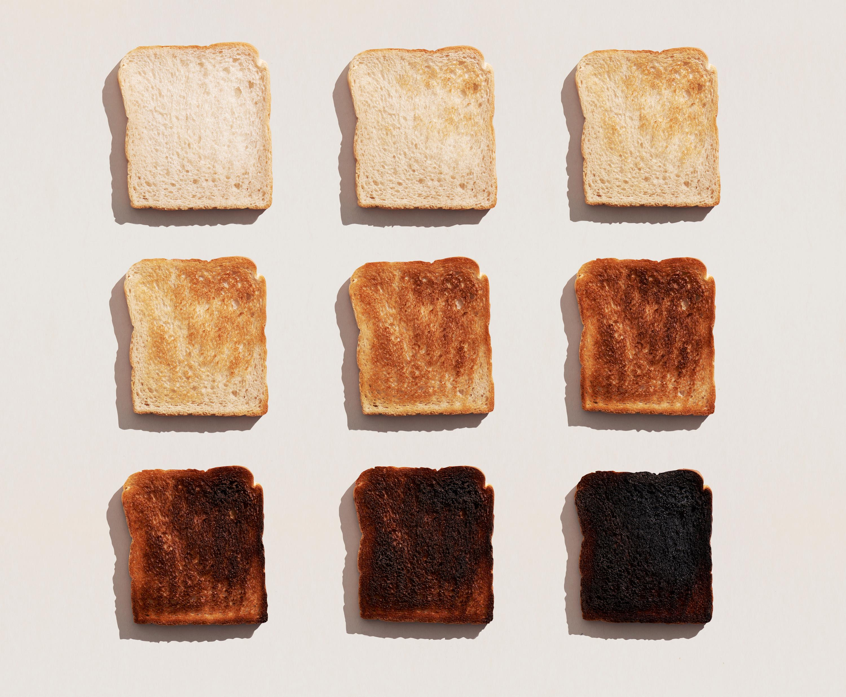
Amazon Food Review Analysis and Prediction

Slide 2
This project investigated user reviews of edible products on Amazon alongside ratings assigned to these items, ranging from 1 to 5. Insights useful for online retail platforms were deduced.
The aim is to employ statistical and machine learning (ML) tools to analyze text data, predict rating based on text and perform topic modelling to discern common themes.
This project comprises 6 parts.

Slide 3
Part 1: Data Exploration, Visualization And Cleaning
▪ 1.1. Get Data
▪ 1.2. Checking for Null Values
▪ 1.3. Inspecting Text
▪ 1.4. Data Cleaning
▪ 1.5. Feature Engineering
▪ 1.6. Correlations
▪ 1.7. Viewing Data Distribution
▪ 1.8. Reducing Skewness
▪ 1.9. Standardization

Slide 4
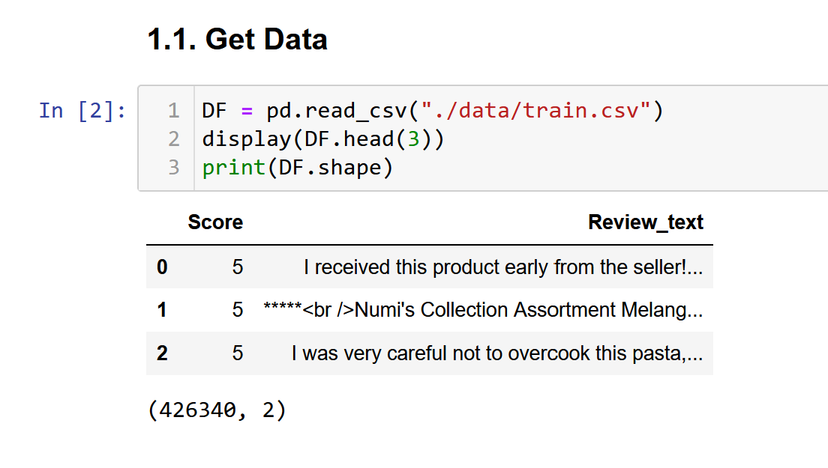
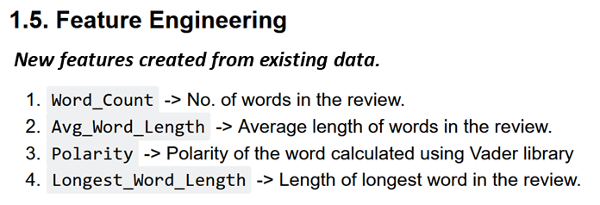
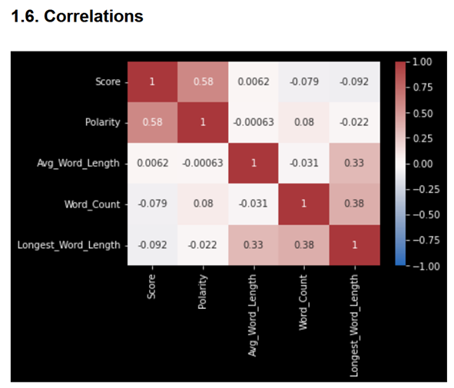
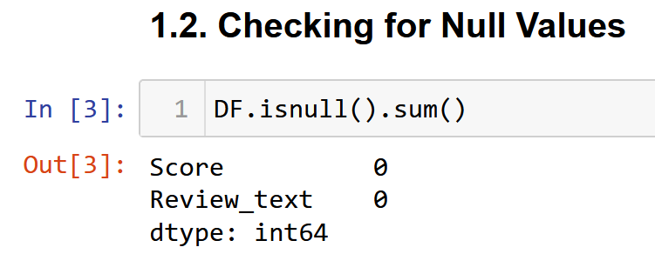
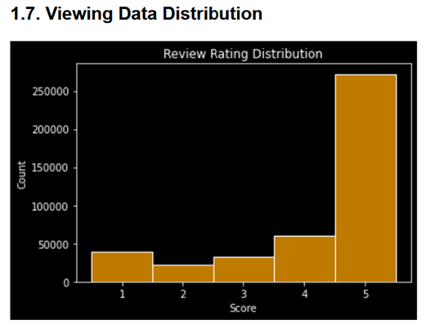
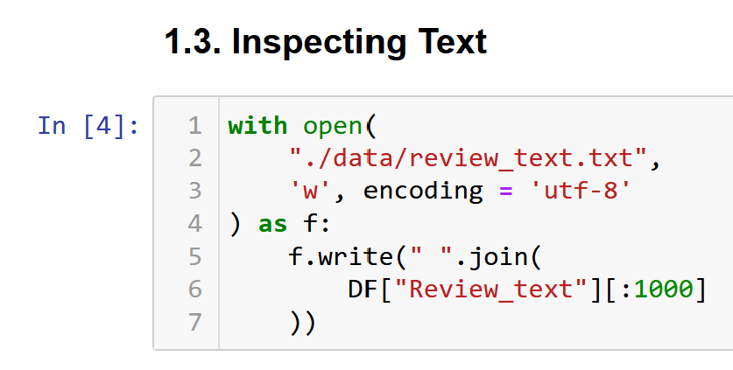
1.4. Data Cleaning
Regex <[^<>]*>, [a^z ]*, \s\s+, (https?\w*)|(www\w*) | Remove matches to remove non-alphabet characters, extra spaces, and URLs.
Emoticons | Replace emoticons such as :D with their textual descriptions.
Upper Case | Make lower case.
‘s | Remove.
Contractions like “don’t”. | Replace with expanded text.
- | Replace dash with space.

Slide 5
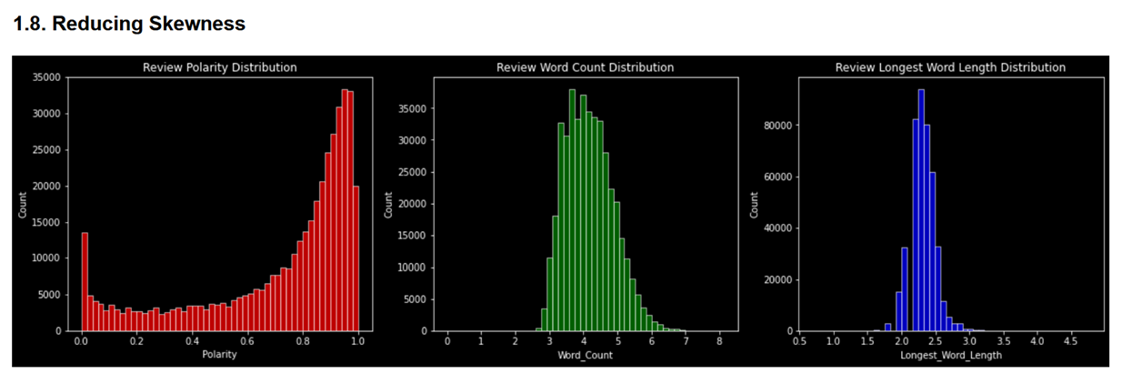
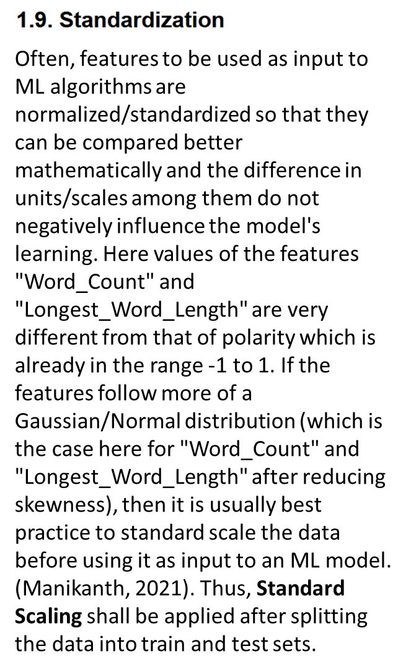
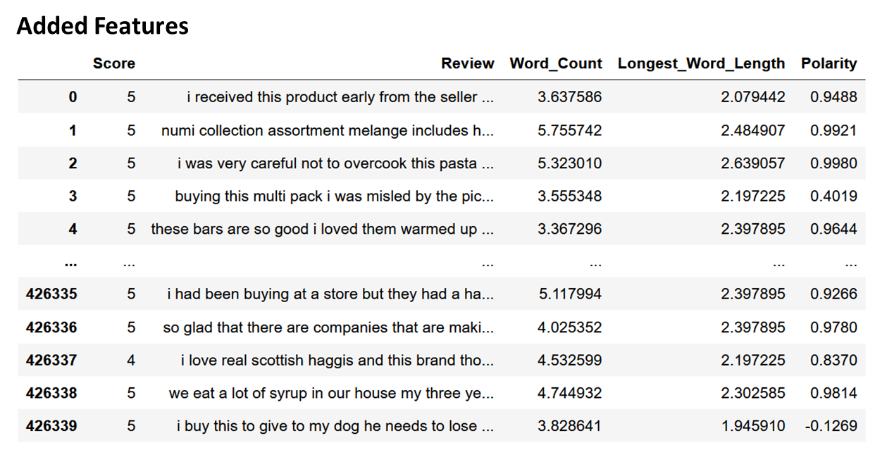

Slide 6
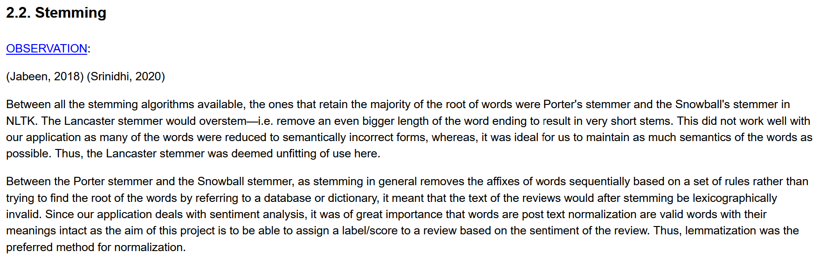
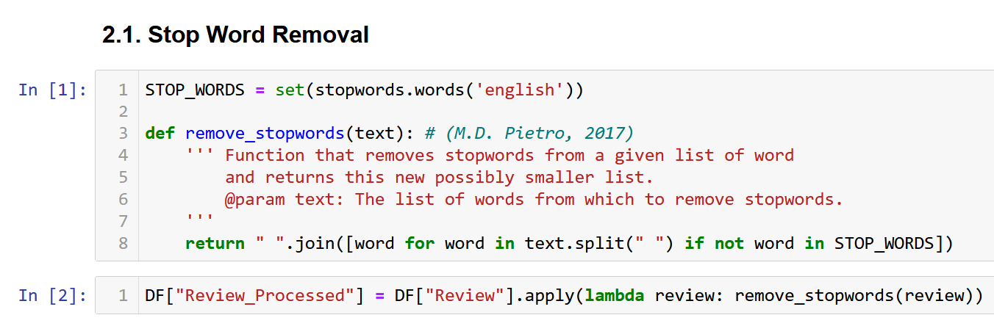
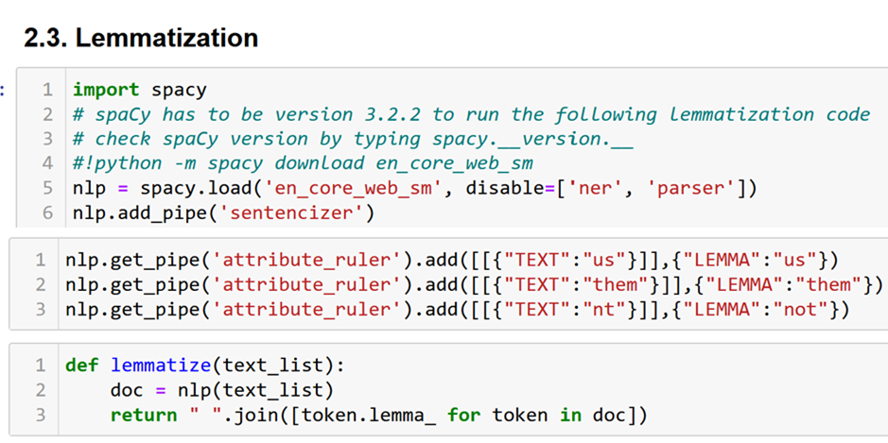
Part 2: Text Processing and Normalization
▪ 2.1. Stop Word Removal
▪ 2.2. Stemming
▪ 2.3. Lemmatization

Slide 7
Part 3: Vector Space Model and Feature Representation
▪ 3.1. Bag Of Words Representation (Term Frequency)
▪ 3.2. Bag Of Words Representation (Term Frequency Inverse Document Frequency)
▪ 3.3. Word Embedding Using GloVe Model

Slide 8
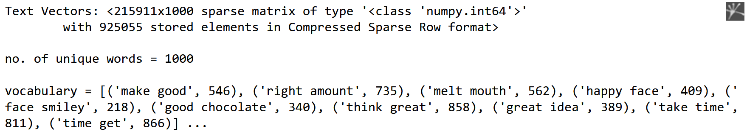
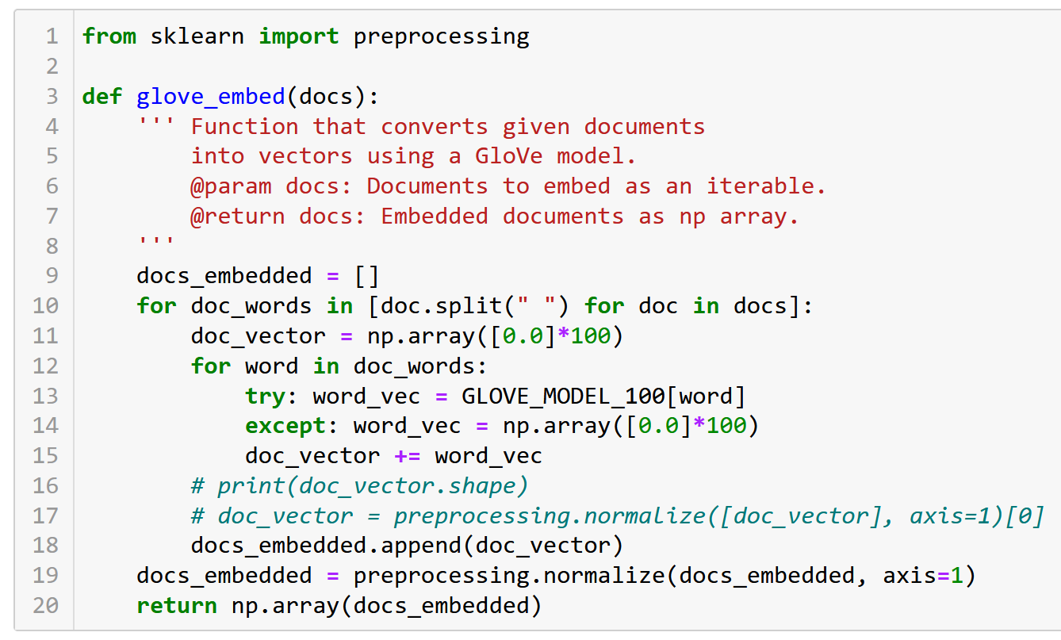
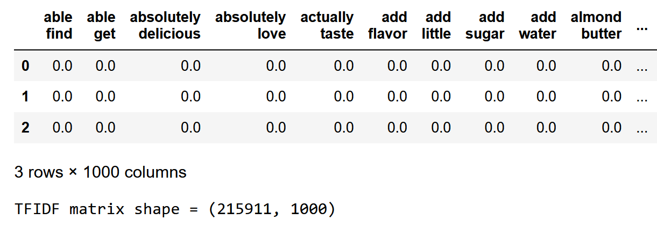
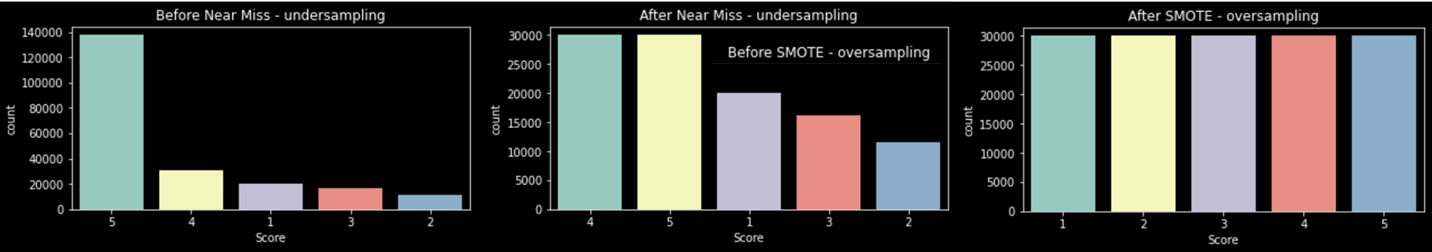

Slide 9
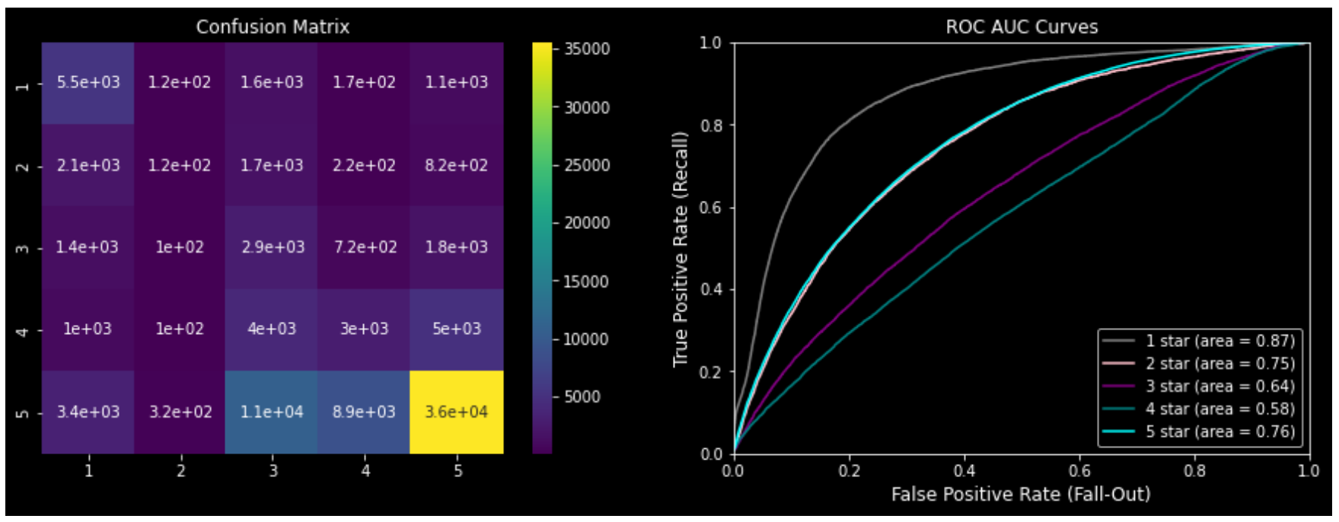
Part 4: Model Selection, Training, Hyperparameter Tuning and Evaluation
▪ 4.2.1. Linear Regression
▪ 4.2.2. Naive Bayes
▪ 4.2.3. Support Vector Machines
▪ 4.2.4. Stochastic Gradient Descent
▪ 4.2.5. Grid Search/Displaying performance measures of all best models

Slide 10
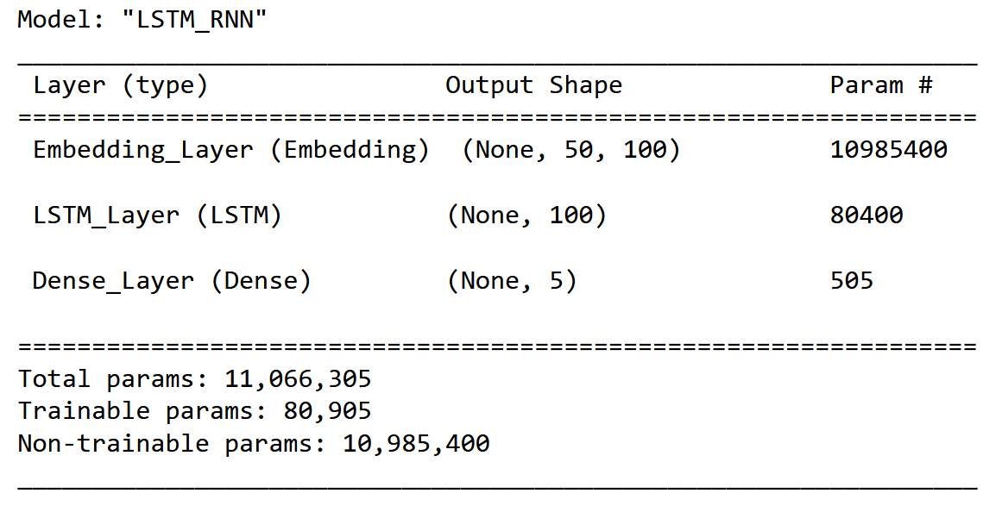
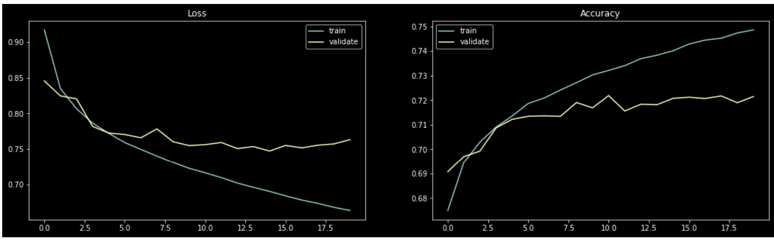
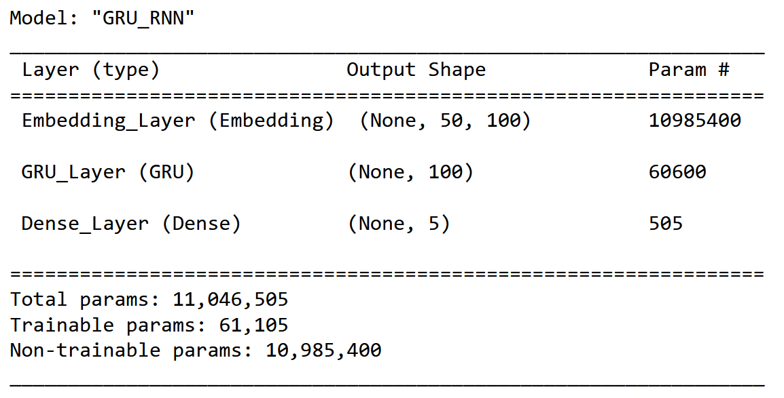
Part 5: Modelling Text as a Sequence
▪ 5.1. LSTM Model
▪ 5.2. GRU Model
▪ 5.3. LSTM Vs GRU

Slide 11
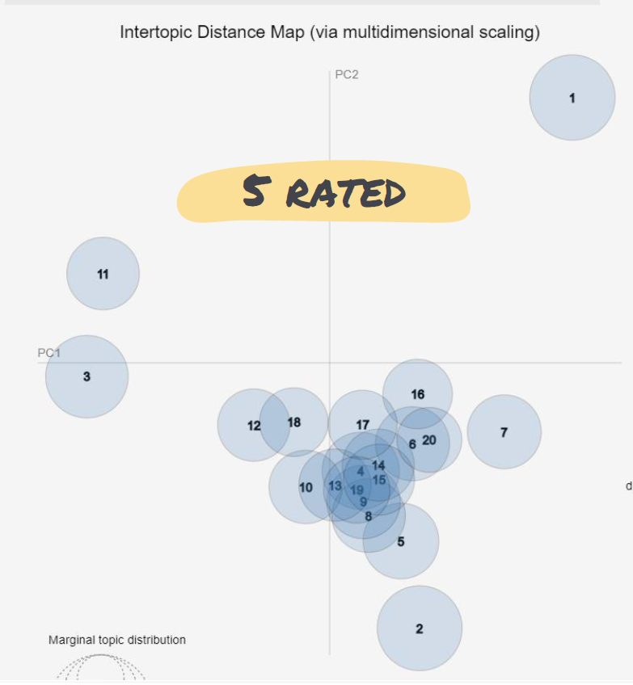
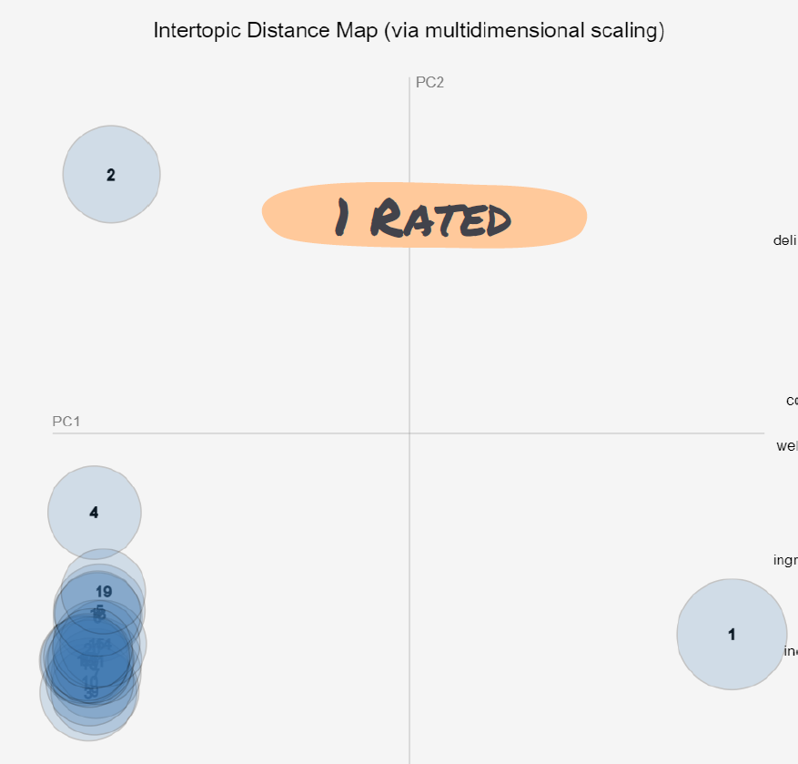
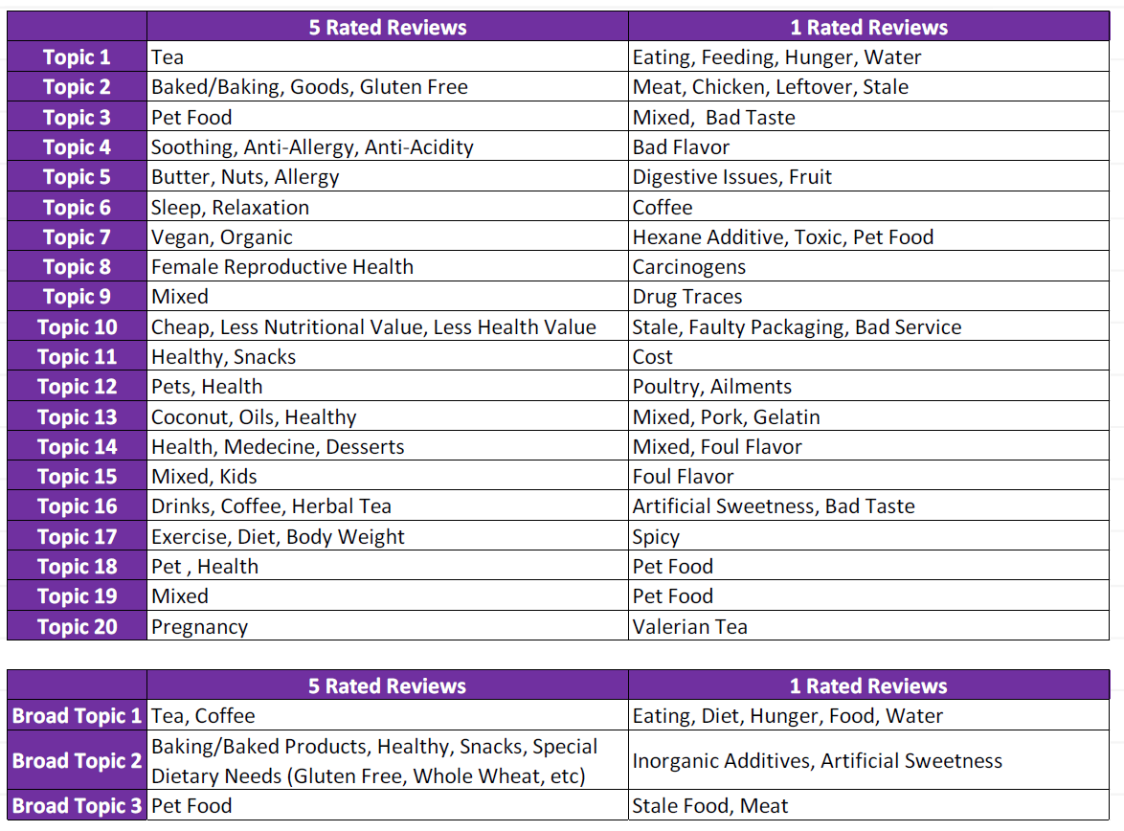
Part 6: Topic Modelling of High and Low Ratings
▪ 6.1. Investigating 5 Star Rated Reviews
▪ 6.2. Investigating 1 Star Rated Reviews
▪ 6.3. Topic Conclusions

